Slide 1
Chapter 2 Program Structure

Slide 2
Expressions and statements
A fragment of code that produces a value is called an expression. Every value that is written literally (such as 22 or "psychoanalysis") is an expression.
An expression between parentheses is also an expression, as is a binary operator applied to two expressions or a unary operator applied to one.

Slide 3
JS - Data Types
There are two types of Data Types in JavaScript – Primitive data type – Non-primitive (reference) data type
Note : JavaScript is weakly typed. Every JavaScript variable has a data type , that type can change dynamically

Slide 4
Bindings or Variable
To catch and hold values, JavaScript provides a thing called a binding, or variable:
let caught = 5 * 5;
The special word (keyword) let indicates that this sentence is going to define a binding. It is followed by the name of the binding and, if we want to immediately give it a value, by an = operator and an expression.
Notes:
The previous statement creates a binding called caught and uses it to grab
hold of the number that is produced by multiplying 5 by 5.
After a binding has been defined, its name can be used as an expression. The
value of such an expression is the value the binding currently holds.

Slide 5
Identifier Naming Conventions
– Use camelCase for identifier names (variables and functions) – The name should be descriptive and concise – All names start with a letter – Variable names are case sensitive
– Variable and function names written as camelCase – Global variables written in UPPERCASE – Constants written in UPPERCASE

Slide 6
Identifier names
Binding names can be any word. Digits can be part of binding names—catch22
is a valid name, for example—but the name must not start with a digit.
A binding name may include dollar signs ($) or underscores (_) but no other
punctuation or special characters.
Words with a special meaning, such as let, are keywords, and they may not
be used as binding names. There are also a number of words that are “reserved
for use” in future versions of JavaScript, which also can’t be used as binding
names.

Slide 7
The full list of keywords and reserved words is rather long.
break ,case ,catch ,class ,const ,continue ,debugger, default, delete, do ,else ,enum ,export ,extends ,false, finally ,for ,function ,if, implements, import, interface, in ,instanceof ,let ,new ,package ,private ,protected, public, return ,static, super, ,switch, this, throw, true, try ,typeof ,var, void ,while ,with , yield.

Slide 8
Primitive data type
● String ● Number ● Boolean ● Null ● Undefined

Slide 9
Non-primitive data types
● Array ● Object

Slide 10
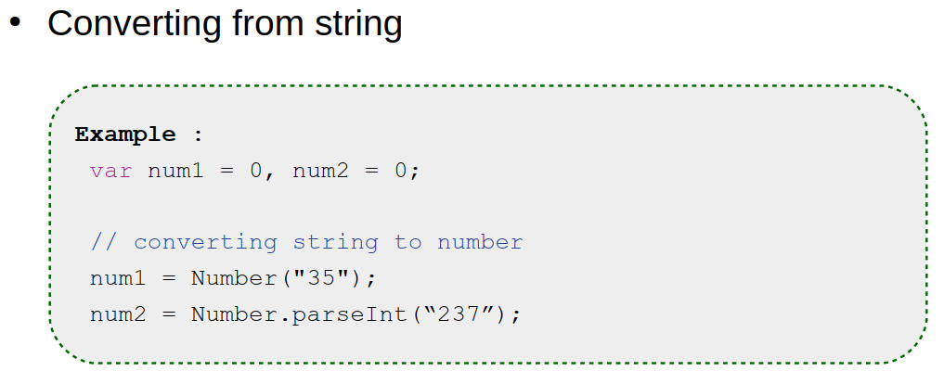
Primitive data type(Number conversion)

Slide 11
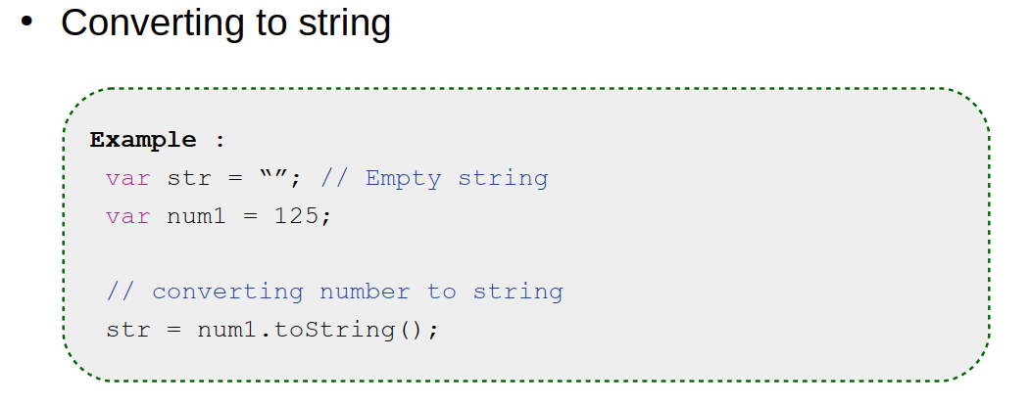
Primitive data type(Number conversion)

Slide 12
Cont.…
Here’s an example:
let ten = 10;
console.log(ten * ten);
// → 100

Slide 13
Cont.…
When a binding points at a value, that does not mean it is tied to that
23 value forever. The = operator can be used at any time on existing bindings to disconnect them from their current value and have them point to a new one.
let mood = "light";
console.log(mood);
// → light
mood = "dark";
console.log(mood);
// → dark

Slide 14
Cont.…
A program can access only the values that it still has a reference to.
When you need to remember something, you grow a tentacle to hold on to it or you reattach one of your existing tentacles to it.
Let’s look at another example. To remember the number of dollars that
Luigi still owes you, you create a binding. And then when he pays back $35, you give this binding a new value.
let luigisDebt = 140;
luigisDebt = luigisDebt - 35;
console.log(luigisDebt);
// → 105
Notes:
You should imagine bindings as tentacles, rather than boxes. They do not
contain values; they grasp them—two bindings can refer to the same value.

Slide 15
Cont.…
When you define a binding without giving it a value, the tentacle has nothing to grasp, so it ends in thin air. If you ask for the value of an empty binding, you’ll get the value undefined.
A single let statement may define multiple bindings. The definitions must be separated by commas.
let one = 1, two = 2;
console.log(one + two);
// → 3

Slide 16
Cont.…
The words var and const can also be used to create bindings, in a way similar to let.
var name = "Ayda";
const greeting = "Hello ";
console.log(greeting + name);
// → Hello Ayda
The first, var (short for “variable”), is the way bindings were declared in pre-2015 JavaScript.
Notes:
For now, remember that it mostly does the same thing, but we’ll
rarely use it in this book because it has some confusing properties.
The word const stands for constant. It defines a constant binding, which
points at the same value for as long as it lives. This is useful for bindings that
give a name to a value so that you can easily refer to it later.

Slide 17
The environment
The collection of bindings and their values that exist at a given time is called the environment. When a program starts up, this environment is not empty.
It always contains bindings that are part of the language standard, and most of the time, it also has bindings that provide ways to interact with the surrounding system.
For example, in a browser, there are functions to interact with the
currently loaded website and to read mouse and keyboard input.

Slide 18
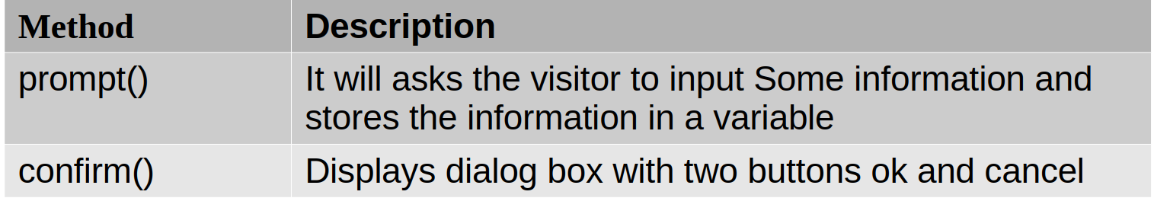
JavaScript - Input

Slide 19
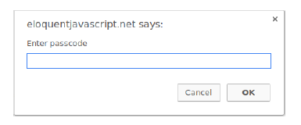
Functions
A lot of the values provided in the default environment have the type function.
A function is a piece of program wrapped in a value. Such values can be applied in order to run the wrapped program.
For example, in a browser environment, the binding prompt holds a function that shows a little dialog box asking for user input.
It is used like this:
prompt("Enter passcode");
Notes:
Executing a function is called invoking, calling, or applying it. You can
call a function by putting parentheses after an expression that produces a
function value. Usually you’ll directly use the name of the binding that holds
the function. The values between the parentheses are given to the program
inside the function. In the example, the prompt function uses the string that
we give it as the text to show in the dialog box. Values given to functions are
called arguments. Different functions might need a different number or different
types of arguments.
The prompt function isn’t used much in modern web programming, mostly
because you have no control over the way the resulting dialog looks, but can
be helpful in toy programs and experiments.

Slide 20
The console.log function
In the examples, I used console.log to output values. Most JavaScript systems (including all modern web browsers and Node.js) provide a console.log function that writes out its arguments to some text output device.
Notes:
In browsers,
the output lands in the JavaScript console. This part of the browser interface
is hidden by default, but most browsers open it when you press F12 or, on a
Mac, command-option-I. If that does not work, search through the menus
for an item named Developer Tools or similar.
Though binding names cannot contain period characters, console.log does
have one. This is because console.log isn’t a simple binding. It is actually an expression that retrieves the log property from the value held by the console
binding.

Slide 21
Return values
Showing a dialog box or writing text to the screen is a side effect. A lot of functions are useful because of the side effects they produce. Functions may also produce values, in which case they don’t need to have a side effect to be useful. For example, the function Math.max takes any amount of number arguments and gives back the greatest.
console.log(Math.max(2, 4));
// → 4
When a function produces a value, it is said to return that value.
Here a call to Math.min, which is the opposite of Math.max, is used as part of a plus expression:
console.log(Math.min(2, 4) + 100);
// → 102

Slide 22
Control flow
When your program contains more than one statement, the statements are executed as if they are a story, from top to bottom. This example program has two statements. The first one asks the user for a number, and the second, which is executed after the first, shows the square of that number.
let theNumber = Number(prompt("Pick a number"));
console.log("Your number is the square root of " +
theNumber * theNumber);
Here is the rather trivial schematic representation of straight-line control
flow:
Notes:
The function Number converts a value to a number. We need that conversion
because the result of prompt is a string value, and we want a number. There
are similar functions called String and Boolean that convert values to those
types.

Slide 23
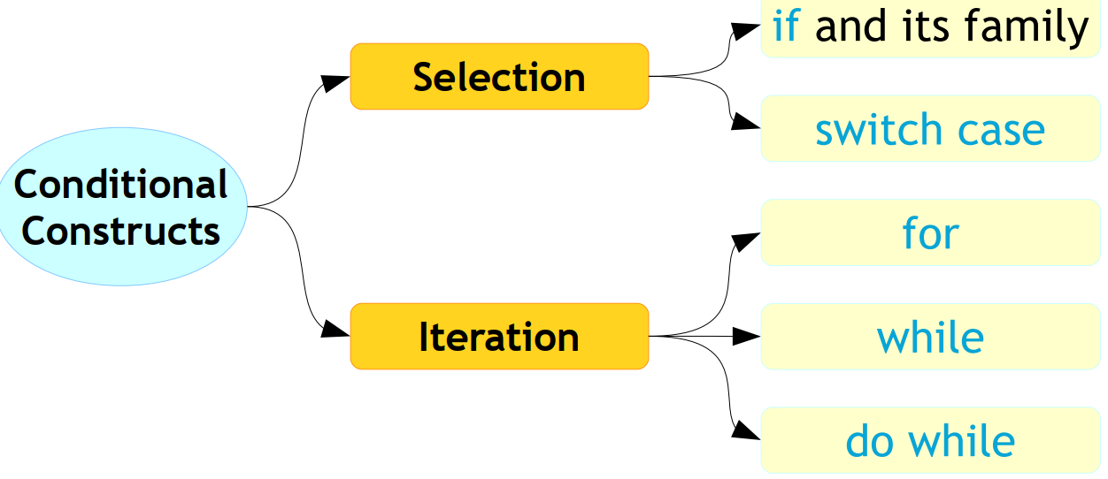
JS – Conditional Construct

Slide 24
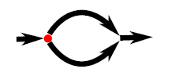
Conditional execution
Not all programs are straight roads. We may, for example, want to create a branching road, where the program takes the proper branch based on the situation at hand. This is called conditional execution.

Slide 25
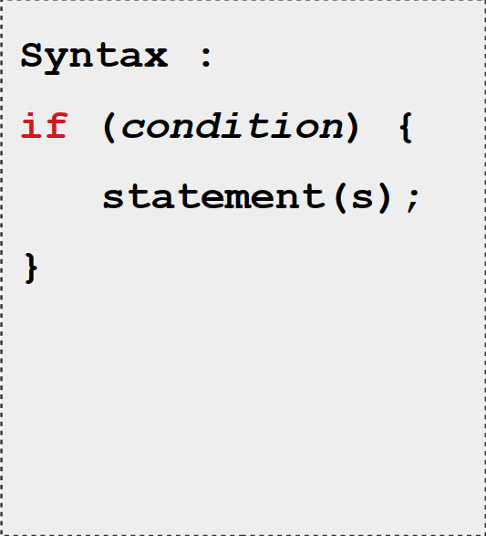
JS – Statements (conditional - if)

Slide 26
Cont.…
Conditional execution is created with the if keyword in JavaScript. In the simple case, we want some code to be executed if, and only if, a certain condition holds. We might, for example, want to show the square of the input only if the input is actually a number.
let theNumber = Number(prompt("Pick a number"));
if (!Number.isNaN(theNumber)) {
console.log("Your number is the square root of " +
theNumber * theNumber);
}
The statement after the if is wrapped in braces ({ and }) in this example.
The braces can be used to group any number of statements into a single statement, called a block.
Notes:
With this modification, if you enter “parrot”, no output is shown.
The if keyword executes or skips a statement depending on the value of
a Boolean expression. The deciding expression is written after the keyword,
between parentheses, followed by the statement to execute.
The Number.isNaN function is a standard JavaScript function that returns
true only if the argument it is given is NaN. The Number function happens to
return NaN when you give it a string that doesn’t represent a valid number.
Thus, the condition translates to “unless theNumber is not-a-number, do this”.
You could also have omitted them in this case, since they
hold only a single statement, but to avoid having to think about whether they
are needed, most JavaScript programmers use them in every wrapped statement
like this. We’ll mostly follow that convention in this book, except for the
occasional one-liner.
if (1 + 1 == 2) console.log("It's true");
// → It's true

Slide 27
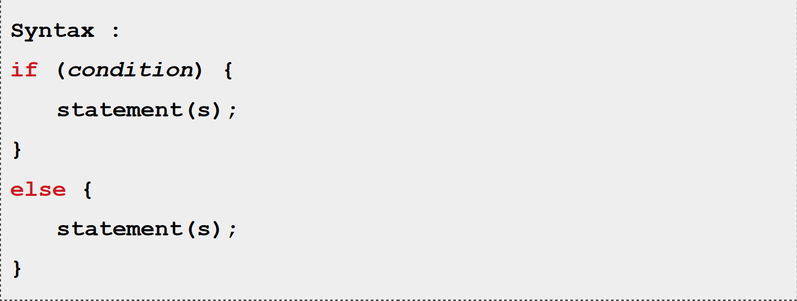
JS – Statements (conditional : if-else)

Slide 28
Cont.…
You often won’t just have code that executes when a condition holds true,
but also code that handles the other case. This alternate path is represented
by the second arrow in the diagram. You can use the else keyword, together
with if, to create two separate, alternative execution paths.
let theNumber = Number(prompt("Pick a number"));
if (!Number.isNaN(theNumber)) {
console.log("Your number is the square root of " +
theNumber * theNumber);
} else {
console.log("Hey. Why didn't you give me a number?");
}

Slide 29
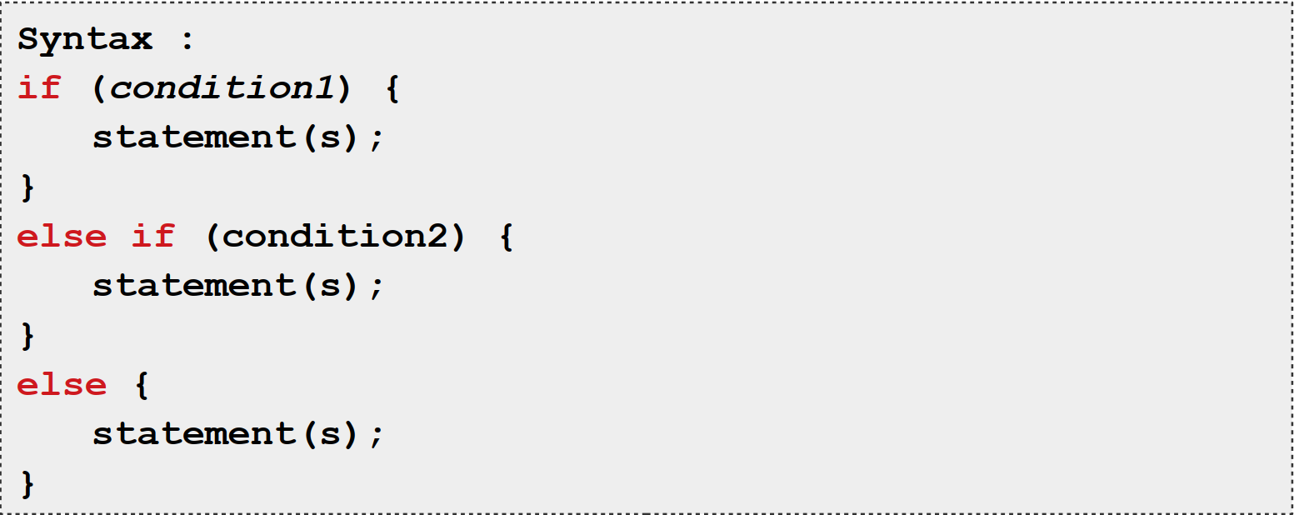
JS – Statements(conditional : if-else if)

Slide 30
Cont.…
If you have more than two paths to choose from, you can “chain” multiple
if/else pairs together. Here’s an example:
let num = Number(prompt("Pick a number"));
if (num < 10) {
console.log("Small");
} else if (num < 100) {
console.log("Medium");
} else {
console.log("Large");
}
Notes:
The program will first check whether num is less than 10. If it is, it chooses
that branch, shows "Small", and is done. If it isn’t, it takes the else branch,
which itself contains a second if. If the second condition (< 100) holds, that
means the number is between 10 and 100, and "Medium" is shown. If it doesn’t,
the second and last else branch is chosen.
The schema for this program looks something like this:

Slide 31
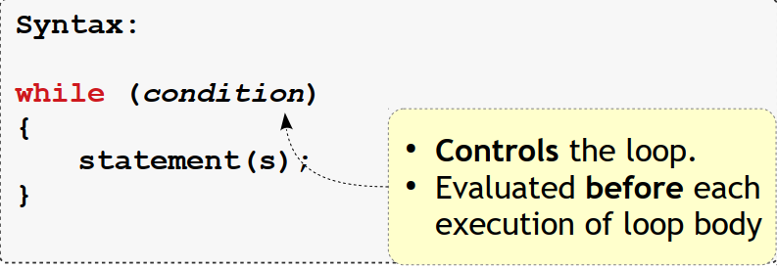
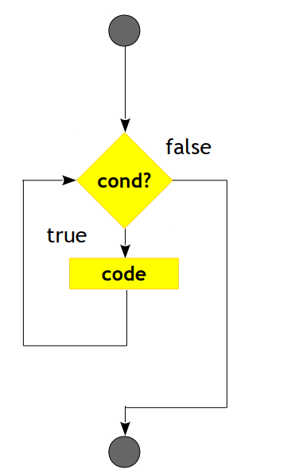
JS – Statements(while)

Slide 32
while and do loops
Consider a program that outputs all even numbers from 0 to 12. One way to
write this is as follows:
console.log(0);
console.log(2);
console.log(4);
console.log(6);
console.log(8);
console.log(10);
console.log(12);

Slide 33

Cont.…
That works, but the idea of writing a program is to make something less
work, not more. If we needed all even numbers less than 1,000, this approach would be unworkable. What we need is a way to run a piece of code multiple times. This form of control flow is called a loop.

Slide 34
Cont.…
Looping control flow allows us to go back to some point in the program where we were before and repeat it with our current program state. If we combine
this with a binding that counts, we can do something like this:
let number = 0;
while (number <= 12) {
console.log(number);
number = number + 2;
}
// → 0
// → 2
// … etcetera

Slide 35

Cont.…
As an example that actually does something useful, we can now write a
program that calculates and shows the value of $2^{10}$ (2 to the 10th power). We
use two bindings: one to keep track of our result and one to count how often
we have multiplied this result by 2. The loop tests whether the second binding
has reached 10 yet and, if not, updates both bindings.
let result = 1;
let counter = 0;
while (counter < 10) {
result = result * 2;
counter = counter + 1;
}
console.log(result);
// → 1024

Slide 36
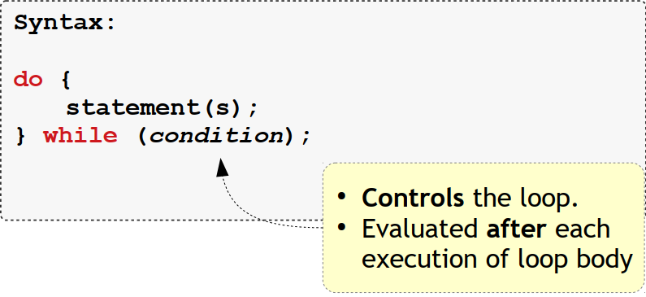
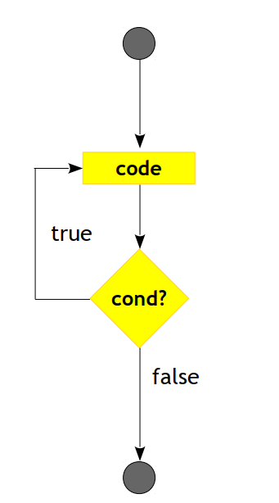
JS – Statements(do - while)

Slide 37
Cont.…
A do loop is a control structure similar to a while loop. It differs only on one point: a do loop always executes its body at least once, and it starts testing whether it should stop only after that first execution. To reflect this, the test appears after the body of the loop.
let yourName;
do {
yourName = prompt("Who are you?");
} while (!yourName);
console.log(yourName);
Notes:
This program will force you to enter a name. It will ask again and again until
it gets something that is not an empty string. Applying the ! operator will
convert a value to Boolean type before negating it, and all strings except ""
convert to true. This means the loop continues going round until you provide
a non-empty name.

Slide 38
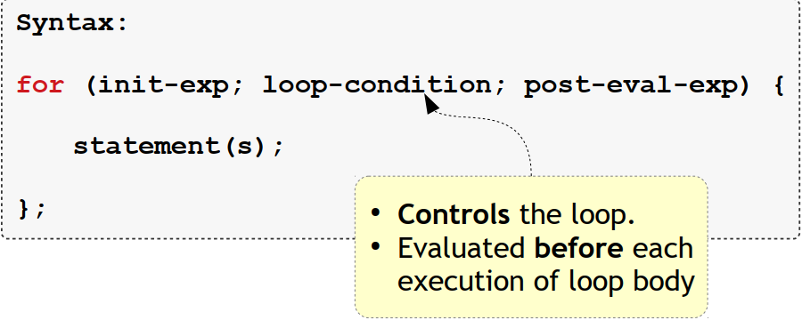
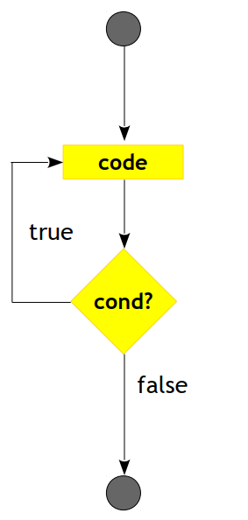
JS – Statements (for loop)

Slide 39
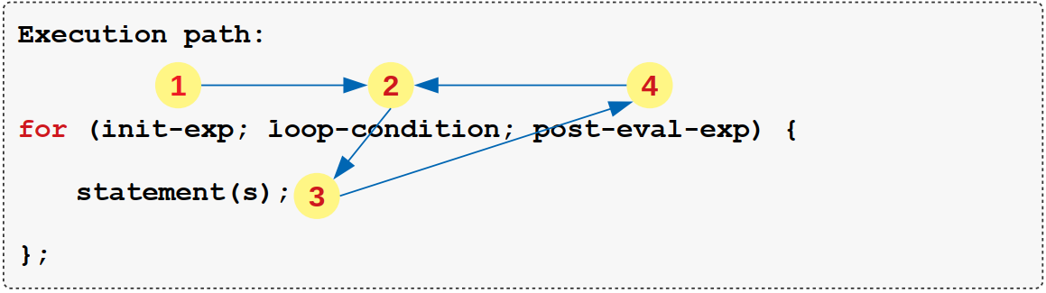
S – Statements(for loop)

Slide 40
for loops
Many loops follow the pattern shown in the while examples. First a “counter”
binding is created to track the progress of the loop. Then comes a while loop,
usually with a test expression that checks whether the counter has reached
its end value. At the end of the loop body, the counter is updated to track
progress.
Because this pattern is so common, JavaScript and similar languages provide
a slightly shorter and more comprehensive form, the for loop.
for (let number = 0; number <= 12; number = number + 2) {
console.log(number);
}
// → 0
// → 2
// … etcetera
Notes:
This program is exactly equivalent to the earlier even-number-printing example.
The only change is that all the statements that are related to the “state”
of the loop are grouped together after for.
The parentheses after a for keyword must contain two semicolons. The part
before the first semicolon initializes the loop, usually by defining a binding.
The second part is the expression that checks whether the loop must continue.
The final part updates the state of the loop after every iteration. In most cases,
this is shorter and clearer than a while construct.
One main difference is while loops are best suited when you do not know ahead of time the number of iterations that you need to do. When you know this before entering the loop you can use forloop.

Slide 41
Cont.…
This is the code that computes 210 using for instead of while:
let result = 1;
for (let counter = 0; counter < 10; counter = counter + 1) {
result = result * 2;
}
console.log(result);
// → 1024

Slide 42
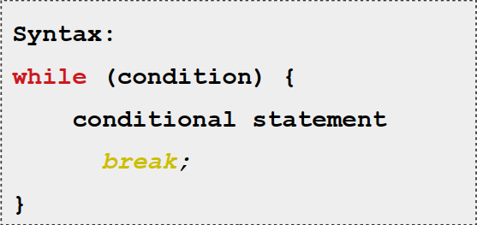
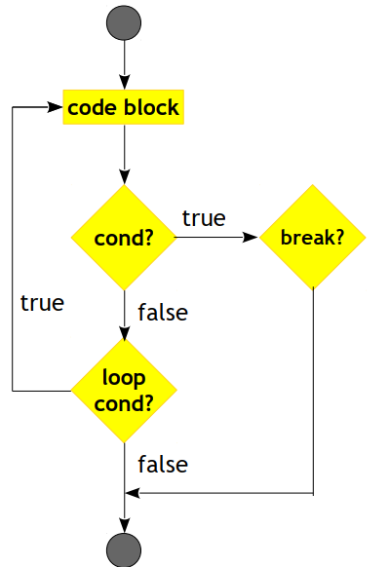
JS – Statements(break)

Slide 43
Breaking Out of a Loop
Having the looping condition produce false is not the only way a loop can finish.
There is a special statement called break that has the effect of immediately
jumping out of the enclosing loop.
This program illustrates the break statement. It finds the first number that
is both greater than or equal to 20 and divisible by 7.
for (let current = 20; ; current = current + 1) {
if (current % 7 == 0) {
console.log(current);
break;
}
}
// → 21

Slide 44
Cont.…
Using the remainder (%) operator is an easy way to test whether a number
is divisible by another number. If it is, the remainder of their division is zero.
The for construct in the example does not have a part that checks for the
end of the loop. This means that the loop will never stop unless the break
statement inside is executed.
If you were to remove that break statement or you accidentally write an
end condition that always produces true, your program would get stuck in an infinite loop. A program stuck in an infinite loop will never finish running,
which is usually a bad thing.

Slide 45
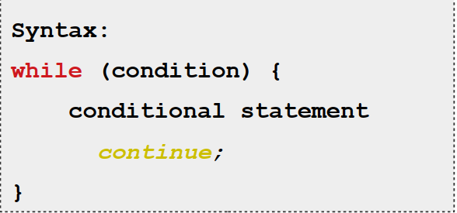
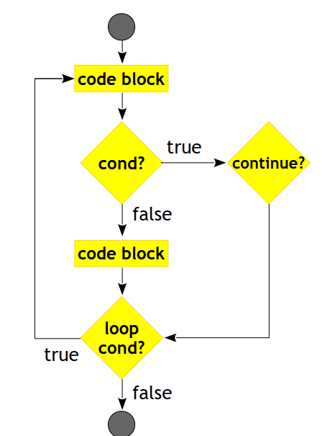
JS – Statements(continue)

Slide 46
Cont.…
The continue keyword is similar to break, in that it influences the progress of a loop. When continue is encountered in a loop body, control jumps out of the body and continues with the loop’s next iteration.
for(let i = 0; i < 10; i ++)
{
if(i == 5){
continue;
}
console.log(i);
}

Slide 47
Updating bindings succinctly
Especially when looping, a program often needs to “update” a binding to hold
a value based on that binding’s previous value.
counter = counter + 1;
JavaScript provides a shortcut for this.
counter += 1;
Similar shortcuts work for many other operators, such as result *= 2 to double result or counter -= 1 to count downward.
This allows us to shorten our counting example a little more.
for (let number = 0; number <= 12; number += 2) {
console.log(number);
}
For counter += 1 and counter -= 1, there are even shorter equivalents:
counter++ and counter--.

Slide 48
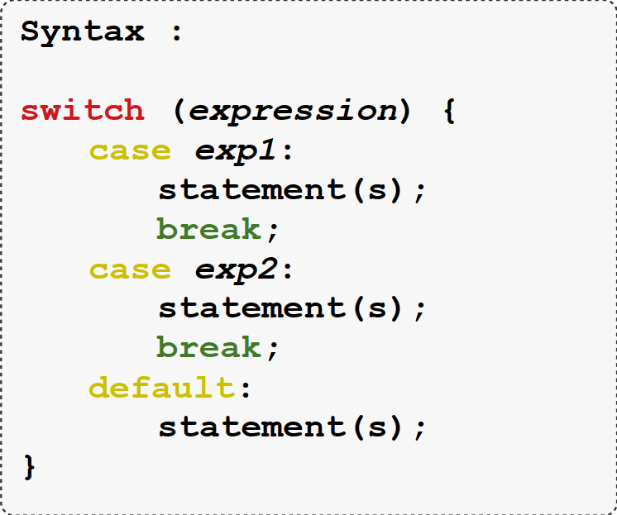
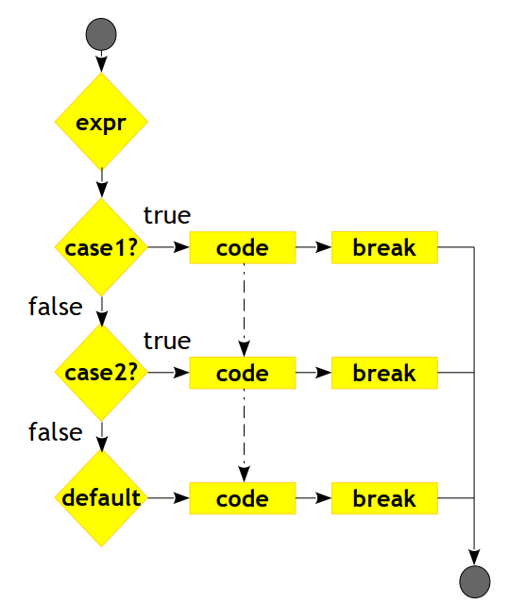
JS – Statements (switch)

Slide 49
Dispatching on a value with switch
There is a construct called switch that is intended to express such a “dispatch” in a more direct way.
Here is an example:
switch (prompt("What is the weather like?")) {
case "rainy":
console.log("Remember to bring an umbrella.");
break;
case "sunny":
console.log("Dress lightly.");
case "cloudy":
console.log("Go outside.");
break;
default:
console.log("Unknown weather type!");
break;
}
Notes:
It is not uncommon for code to look like this:
if (x == "value1") action1();
else if (x == "value2") action2();
else if (x == "value3") action3();
else defaultAction();
There is a construct called switch that is intended to express such a “dispatch”
in a more direct way. Unfortunately, the syntax JavaScript uses for
this (which it inherited from the C/Java line of programming languages) is
somewhat awkward—a chain of if statements may look better.
You may put any number of case labels inside the block opened by switch.
The program will start executing at the label that corresponds to the value
that switch was given, or at default if no matching value is found. It will
continue executing, even across other labels, until it reaches a break statement.
In some cases, such as the "sunny" case in the example, this can be used to
share some code between cases (it recommends going outside for both sunny
and cloudy weather). But be careful—it is easy to forget such a break, which
will cause the program to execute code you do not want executed.

Slide 50
Comments
A comment is a piece of text that is part of a program but is completely ignored by the computer. JavaScript has two ways of writing comments. To write a single-line comment, you can use two slash characters (//) and then the comment text after it.
let accountBalance = calculateBalance(account);
// It's a green hollow where a river sings
A // comment goes only to the end of the line. A section of text between /* and */ will be ignored in its entirety.
/*
I first found this number scrawled on the back of an old notebook.
Since then, it has often dropped by, showing up in phone numbers
and the serial numbers of products that I've bought. It obviously
likes me, so I've decided to keep it.
*/

Slide 51
Summary
You now know that a program is built out of statements, which themselves sometimes contain more statements. Statements tend to contain expressions, which themselves can be built out of smaller expressions.
Putting statements after one another gives you a program that is executed from top to bottom. You can introduce disturbances in the flow of control by using conditional (if, else, and switch) and looping (while, do, and for) statements.
Bindings can be used to file pieces of data under a name, and they are useful
for tracking state in your program. The environment is the set of bindings that are defined. JavaScript systems always put a number of useful standard bindings into your environment.
Functions are special values that encapsulate a piece of program. You can
invoke them by writing functionName(argument1, argument2). Such a function
call is an expression and may produce a value.

